Slide 1
Innovation & Entrepreneurship Activities
Group 2
IQBAL AQSA 2019380162
MAHMUD ABRAR AL 2019380188
ABID ALI 2019380141

Slide 2
What is Innovation in Entrepreneurship?
Innovation is about the process and organization needed to generate ideas in any context. The ability to innovate in this sense isn't just a vital component of a thriving business, but can be seen as an essential aspect of entrepreneurship itself.
Innovation enhances the nature, creativity, and design thinking process of a brand
can open the doors of various opportunities by helping the business to keep up with the current trends.

Slide 3







Six Types of Innovations
On the Huawei
Product --- what we produce and sell.
Service --- exceeding customer expectations.
Process --- continuous improvement of how we do things.
Management --- business strategies, systems and structures.
Open --- working beyond boundaries and collaborating globally

Slide 4
What is Huawei?

Slide 5




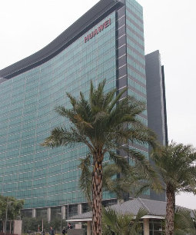
The company was founded in 1987 by Ren Zhengfei, a former Deputy Regimental Chief in the People's Liberation Army. Initially focused on manufacturing phone switches, Huawei has expanded its business to include building telecommunications networks, providing operational and consulting services and equipment to enterprises inside and outside of China, and manufacturing communications devices for the consumer market. Huawei has over 194,000 employees as of December 2019.

Slide 6
Huawei is the world's leading provider of information and communications solutions in:
……
Enterprise network
……
Telecommunications networks
consumer
cloud computing
Huawei has built end-to-end cyber security framework

Slide 7
Products and solutions have been used in more than 140 countries
Has served one-third of the world's population.

Slide 8
How Huawei grew to dominate the world?
Huawei has vastly more resources than its competitors for costly new product development. In fact, in new fifth-generation (5G) wireless technology, Huawei is setting the standard for product leadership because it made massive investments in the technology very early.
The company has also expanded into the consumer market. It became the second-largest vendor of smartphones back in 2018 and is developing its own chips to offer proprietary products.

Slide 9
Innovations
What advantages does Huawei products have over other comparable products?
As for Huawei’s products, they are setting new standards and uniqueness in so many ways such as the Mate 10 Series that we recently launched, which incarnates a series of firsts:
The World’s First AI Processor Inside a Smartphone
The World’s First AI-Powered Photography Technology
The World’s Longest Battery Life
The World’s First TÜV Safety Certified Charging Technology
The World’s Fastest 4.5G Experience

Slide 10

Local innovative collaborations:
Partnership with The Executive Council to become one of the first smartphone companies to adopt the Dubai Font in OS in 27 languages.
Aligned to UAE Happiness Agenda – Happiness meter in Huawei customer service centers to measure customer happiness in real time and interact immediately to solve problems.

Slide 11
transforming Huawei into an employee-owned firm
Success secret:
A Special type of Love for the workforce
In the 1990s, Huawei devised an employee stock ownership scheme through which its employees’ incomes were based on three elements: salary, performance and stock dividend. By adopting such approach to compensation, Huawei wanted to deploy a principle known as “knowledge-ism”, which is grounded on letting and encouraging employees to think of themselves as owners who benefit from the overall success of the firm, and not as replaceable staffs whose contributions are minimized. By transforming Huawei into an employee-owned firm, allowed the company to recruit and keep top talents within its ranks and away from its competitors.
Innovation driven by customers
Long-term R&D projects

Slide 12
Fun fact: CEO Mr. Zhengfei holds only 1.4 percent of ownership in the company while about over 82,000 of the firm’s employees own the rest

Slide 13

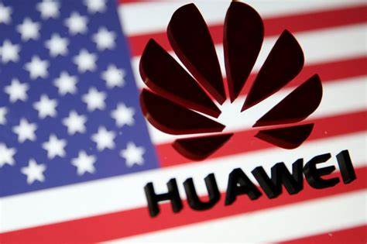
Trade war and the consequences:
By the second quarter of 2020, Huawei captured a massive 60% share of the 5G smartphone market. Huawei reached its highest ever share in China capturing 46% of sales volumes.
But, after the trade war Huawei’s global market share hit the rock bottom.
On September 15th, 2020 the US has implemented the new restriction for shipping semiconductors containing the US technology. The rule is to prevent Huawei from sourcing chips, mainly for the telecommunication area such as smartphones and base stations.

Slide 14

Before that, Huawei was one of the top smartphone brands with around 20% market share and also a top supplier of telecom base stations to global carriers with more than 30% market share. So, it appeared to be really critical for the Chinese semiconductor industry.
Chinese government intended to localize its semiconductor production. As a result Huawei decided to produce own smartphone chips.

Slide 15
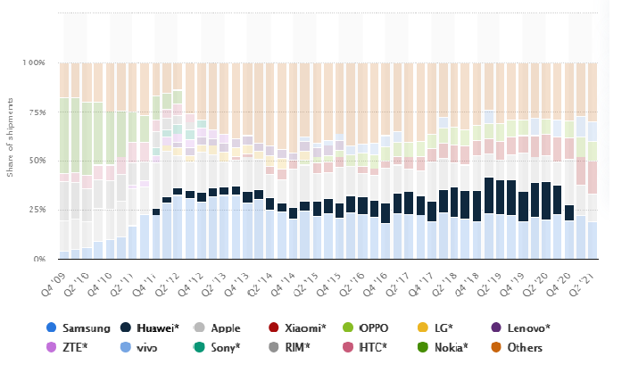
Global smartphone market share from 4th quarter 2009 to 2nd quarter 2021

Slide 16

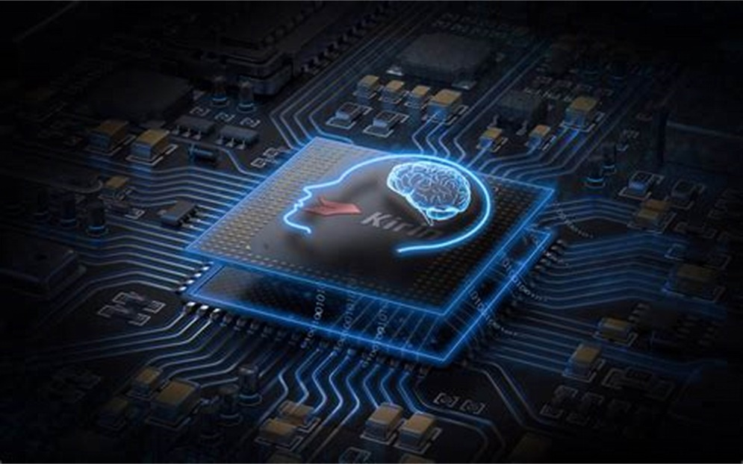
Chip shortage and Huawei’s initiatives:
Huawei, so far, has been developing Kirin chips through its HiSilicon subsidiary.
The project was established in 2019 with the name “HiSilicon Factory”. Huawei has reportedly invested CNY 1.8 billion in this facility.
The factory currently employees over 10,000 research and development personnel who focus on the optical communication modules, HiSilicon chips, and laser radars.

Slide 17
Due to the chip shortage the cost of manufacturing smartphones are getting higher and higher. Huawei has to become self-sufficient with their own microchips before their high-end Kirin chip’s supply ends.
The semiconductor industry requires years of massive investment with no immediate return. It took more than a decade for the Huawei-owned HiSilicon to only have a seat in the global chip market.

Slide 18
Our suggestion in this situation:
we suggest Huawei to solely focus on the research and producing microchips and start outsourcing manufacturing and assembling. For that, they should put their eyes on South-East Asia.
to make the smartphones cheap enough to have the possession on the consumers of India, Pakistan and Bangladesh as almost US and all their western allies have turned their back on Huawei.

Slide 19
Huawei needs to switch from in-home assembling to outsource them from Bangladesh, India or Pakistan where smartphone brand Xiaomi has been doing their business monopoly. Xiaomi and Oppo have a bigger market in those countries because they’ve been already manufacturing smartphones there. Whereas, India, Bangladesh are the biggest market for Xiaomi.
But, India will be more challenging for Huawei, because India is also one of the closest allies of the US.

Slide 20
Why Pakistan or Bangladesh would be a better option?
ISLAMABAD: As the government has introduced tax incentives for assembling/manufacturing of mobile phones through the recently issued presidential order, at least three new mobile phone companies have shown interest in setting up their plants in Pakistan.
“Three new entrants have submitted applications for establishment of manufacturing units in the country,” said an official of the Engineering Development Board (EDB), which is an attached department of the Ministry of Industries and Production.
“Vivo plans to setup its unit in Faisalabad; Airlink has applied for a unit in Lahore; whereas Advance Telecom wants to establish one in Karachi.”

Slide 21
Asia-Pacific would account for majority of the global mobile phone demand primarily due to first time smart phone users. A high percentage of the demand in Asia-Pacific region is expected to be met by Chinese OEMs, such as Huawei, Xiaomi, Oppo.
International mobile phone brands Nokia, Samsung, Vivo and others are increasingly choosing to set up manufacturing ventures in Bangladesh to avoid the South Asian country's high import tariffs and get direct access to its large and growing population.

Slide 22
Mobile Phone Assembling Business in Bangladesh:
Thanks to an effective price gap of 15-26% between imported and locally assembled smart phones, domestic production has climbed, now accounting for nearly 80% of sales.
Local manufacturing of phones only began in October 2017 when local electronics maker Walton started production under its own brand in a Dhaka suburb. It has since made 1.7 million smart phones and 4.3 million older-style feature phones.
A number of other companies now making smart phones in Bangladesh are local ventures, often arms of large conglomerates. But Vivo and Realme, both under the umbrella of China's BBK Electronics, and compatriot Transition have set up their own factories in the country.

Slide 23
Mobile Phone Assembling Business in Bangladesh:
33 million mobile handsets were made in Bangladesh over the past one and a half years, including 18.8 million in last six months.
Bangladesh imported 16.3 million mobiles in last one and a half years with only 1.8 million of them imported in the last six months. Before domestic production began in 2017, Bangladesh needed to meet the local consumption through 100% import of handsets. Now the plants import small parts and assemble the handsets.
The handset market in Bangladesh is worth over Tk 100 billion or roughly $1.2 billion.
12 companies have already got the license to make mobile, such as :
Walton Digi-tech Industries Ltd, Samsung, Symphony, 5 Star, itel and Techno, Yunstar, Vivo , Lava, DTC, Oppo, and Okay Mobile and Mycel Technology.
The annual demand in Bangladesh is more than 35 million handsets, including 11 million smart phones made or assembled locally. Over 60 percent of the feature phones are made or assembled in Bangladesh. The plants will be able to meet the demand fully in a short time.

Slide 24
Potential market to exploit in Bangladesh
Currently, almost 100 percent of the demand for Samsung phones is met by locally assembled. Samsung Bangladesh and its local partner Fair have been assembling smart phones in the plant at Narsingdi since June 2018 to cater the local market. The handsets are cheaper now since they are assembled there. Also, the sector has generated more than 15, 000 jobs. Earlier, there wasn't any opportunity to create skilled labour in making mobile handsets. This sector has just begun to gain the skills.
Walton is set to export smart phones to the US, in what can be viewed as a remarkable endorsement of the leaps taken by Bangladesh's manufacturing sector. The first consignment of the smart phones, which would be priced between $100 and $200, will be out of the gates of Walton Digi-Tech.

Slide 25
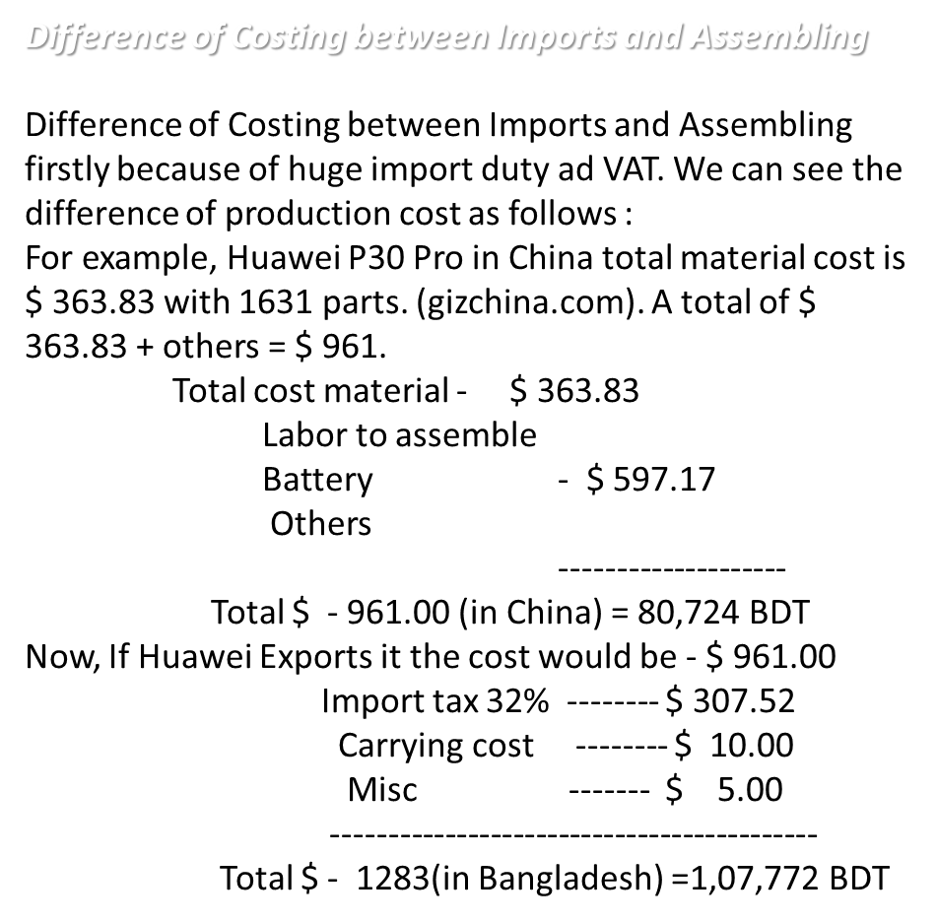
But, if Huawei assembles the product in Bangladesh the price would be,
Total cost material -- $ 363.83
Import tax17%(for assemble) = $ 61.71
Labor cost
Sea freight CIF
Customs = $ 493
Carrying Charge
C & F Charge
Misc
----------------------------------
Total - $ 918.00 in Bangladesh = 77,157 BDT

Slide 26
Minimum Wage in Bangladesh, 1,500 taka ($19) per month for all economic sectors not covered by industry-specific wages; in the garment industry the minimum wage raised to 8,000 taka ($95) per month since 1 December 2018. Where nominal wage is as low as 0.09$ per hour, with PPP that goes to 0.23$. In china, the minimum wage is almost 1$ and with PPP it goes up to 1.68$ per hour.
Average assembling cost of Huawei Smartphone is almost 14$ per phone but Huawei can cut it to half if they move their assembling facilities.
Monthly, it’s almost 549 RMB, where in Shenzhen standard monthly minimum wage is 2,200 RMB.
Other important factors
• Unemployment
• Higher rate of secondary and vocational education than other developing countries
• Chance to maximize the growth in Asia as, cell phone price will get a cap and mass people will be able to afford them.
• Already assembling and manufacturing phones

Slide 27
Thank You!
Any questions?

